Slide 1
Case Study – Assignment 1
Group 2
Albane CHALLAMEL
Antonio LUQUE MOLINA
Léo PEDER
Johan PEDROLI
Erwan SABAROTS

Slide 2
Spar

Slide 3

Spar
Grocery collection service
Allows customers to create shopping lists that get collected and delivered by Spar’s employees
Available world-wide

Slide 4
Spar
Employees have dedicated tablets displaying the list
We need to design the collection side of the system
The customer side is already developed

Slide 5

Requirements
Functional
Non-Functional
What the system should do
What the system should deal with
Web Based
Tablets receive list to be collected
or unavailableEmployees can mark items as collected
When collection is done, the list should be transferred to payment engine
Offline support is a must

Slide 6
1. “How many expected concurrent users ?”
NFR - What We Ask
200
2. “How many lists will be processed per days ?”
10,000
3. “What is the average size of a shopping
list ?”
500 KB

Slide 7
4. “Do we need offline support ?”
NFR - What We Ask
Yes !
5. “What is the desired SLA ?”
Highest Possible
6. “How do lists arrive to the system?”
Queue

Slide 8
Data Volume
Lists per day: 10 000
Size list: 500 KB
Total storage per days: 5 000 000 KB → 5 GB/day
Total storage per years: 5M KB * 365 → 1,825 TB/year

Slide 9
Requirements
Functional
Non-Functional
What the system should do
What the system should deal with
Web Based
Tablets receive list to be collected
Employees can mark items as collected or unavailable
When collection is done, the list should be transferred to payment engine
Offline support is a must
200 Concurrent users
10,000 lists/day
Yearly volume: 1,825TB
Level of SLA – 99,95 %
Support – offline or online?
Notes:
The total composite SLA is:
Web app and (database or queue) = 99.95% × 99.99999% = ~99.95%
Source: https://learn.microsoft.com/en-us/azure/well-architected/resiliency/business-metrics

Slide 10
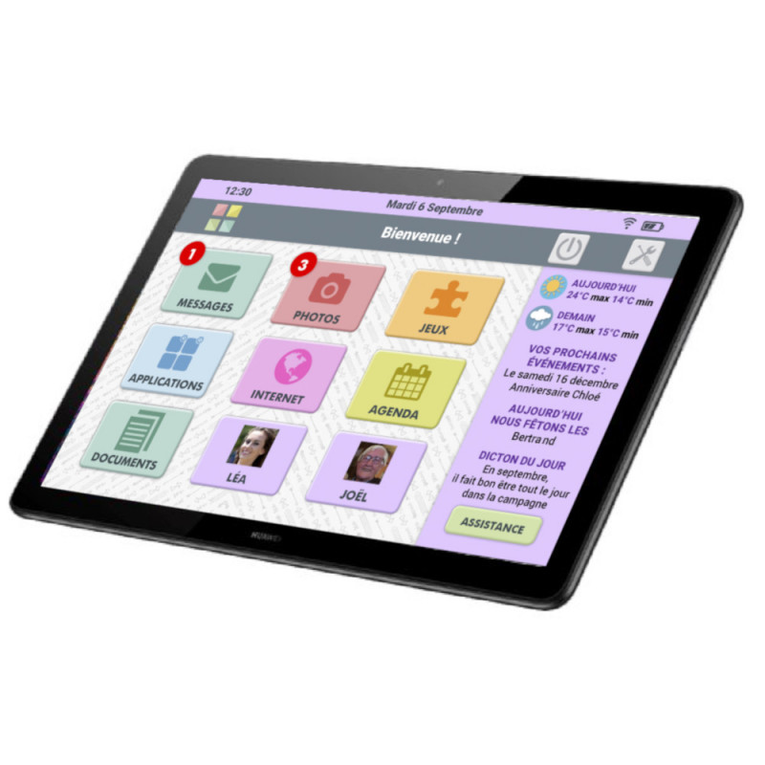
Components
Collect list Service
Payment Transfert
View Service
Tablets
Offline service
Online service
Sends payment data to payment system
Returns static files to the application with HTTP/CSS
Interface between employees and the systems
Store lists locally for offline working
Manage lists with items and updates
Data Store
Logging
Payment Engine

Slide 11

Components
Tablets
Collect list Service
HTML page
Offline service
Online service
View Service
REST API/ HTTP
Queue
Payment Transfert
Database
Logging
Payment Engine

Slide 12
Components
Tablets
Collect list Service
HTML page
Offline service
Online service
View Service
REST API/ HTTP
Queue
Payment Transfert
Database
Logging
Payment Engine

Slide 13
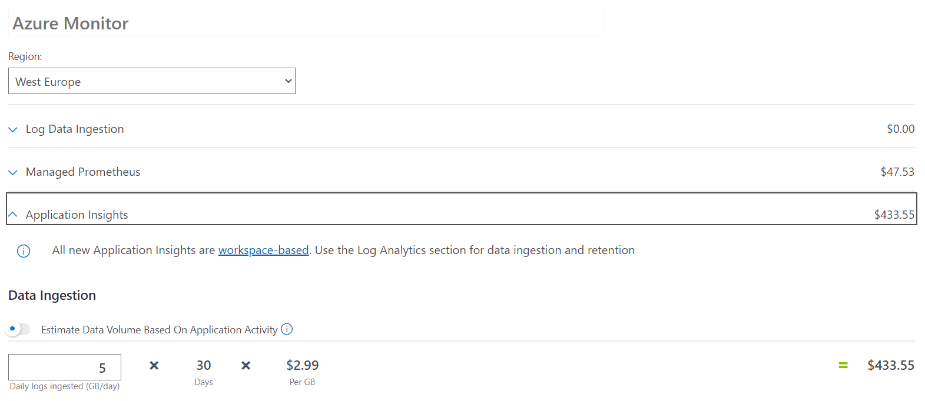
Logging
Azure log analytics
Logging
Notes:
Azure log analytics provides access to logs and good integration with many services, which is useful in our situation. Azure log analytics provides access to logs and good integration with many services, which is useful in our situation.

Slide 14

Database
Azure SQL Database
Structured data (like items list)
Database
Notes:
We have chosen to use a Azure SQL Database instead of a Azure cosmos db because our database is structured (articles, lists).
Source: https://the-tech-guy.in//azure-cosmos-db-vs-azure-sql-database/#:~:text=Query%20Language%3A%20Azure%20Cosmos%20DB,is%20the%20way%20to%20go.
2023/04/14

Slide 15
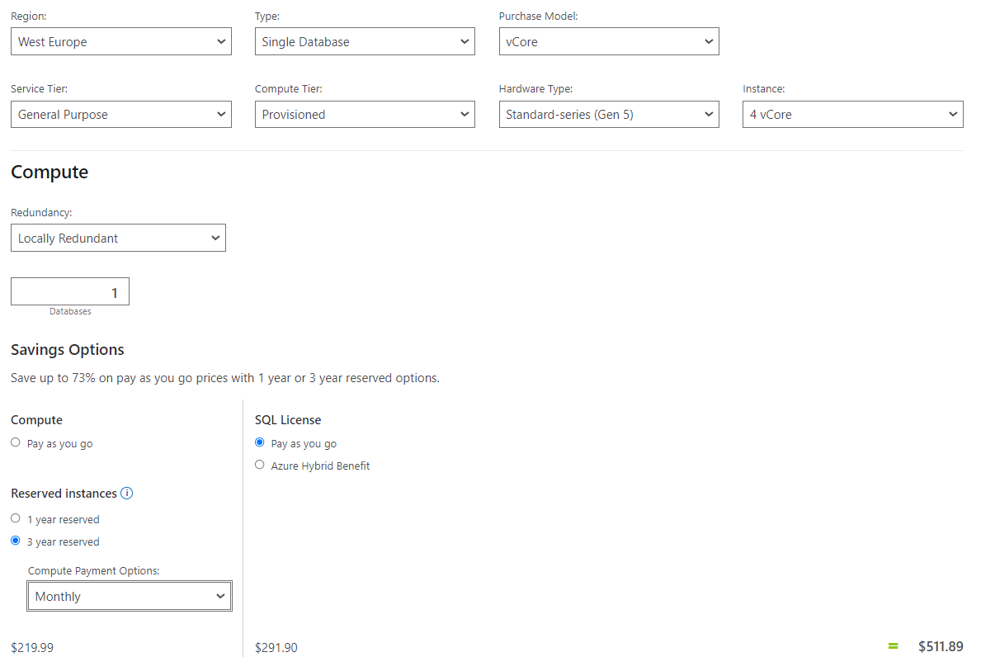
Database
Database
Notes:
We have chosen to use a Azure SQL Database instead of a Azure cosmos db because our database is structured (articles, lists).
Source: https://the-tech-guy.in//azure-cosmos-db-vs-azure-sql-database/#:~:text=Query%20Language%3A%20Azure%20Cosmos%20DB,is%20the%20way%20to%20go.
2023/04/14

Slide 16

Components
Tablets
Collect list Service
HTML page
Offline service
Online service
View Service
REST API/ HTTP
Queue
Payment Transfert
Logging
Payment Engine

Slide 17
View Service
What it does :
Displays the list of items to be collected
Application mobile
View Service

Slide 18
Application Type
Web App & Web API - ✗
Mobile App - ✔ (Tablets)
Console - ✗
Service - ✗
Desktop App - ✗
View Service

Slide 19


Technology Stack
View Service
Notes:
The most sensible choice is to use .NET with Xamarin, which is an app platform for developing apps (compatible with IOS and Android tablets, etc.).
Source: https://dotnet.microsoft.com/en-us/apps/xamarin

Slide 20
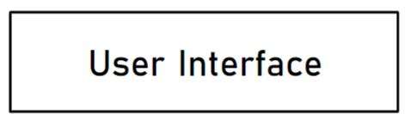
Architecture
View Service
Notes:
This service is just a view service for the user

Slide 21
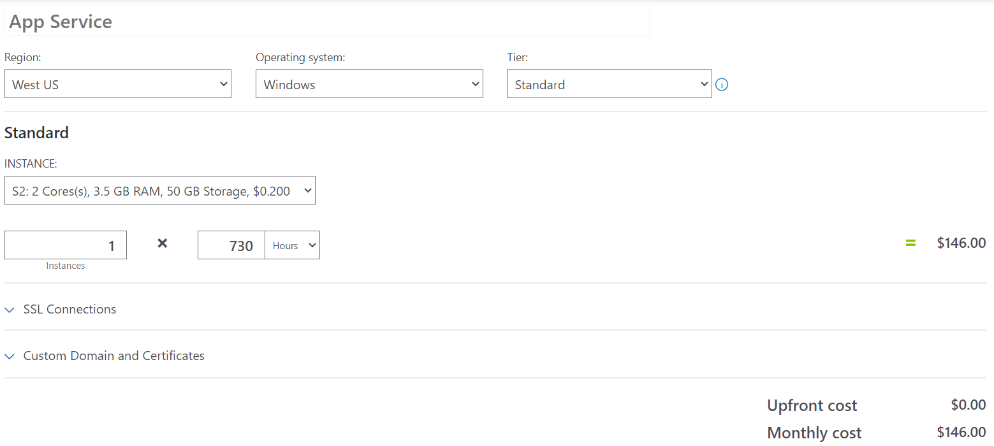
Mobile App on Azure
App service:
Supports many platforms (tablets)
Stadard tier has SLA 99,95%
View Service
Notes:
Instance 2 because we have 100 users.

Slide 22

Components
Tablets
Collect list Service
HTML page
Offline service
Online service
App service
REST API/ HTTP
Queue
Payment Transfert
Logging
Payment Engine

Slide 23
Collect list Service Online part
What it does :
Receive list with items from tablet
Mark items as collected or unavailable
Validate a list where is done
Collect list Service (Online)

Slide 24
Application Type
Web App & Web API - ✔
Mobile App - ✗
Console - ✗
Service - ✗
Desktop App - ✗
Collect list Service (Online)

Slide 25
Technology Stack
Collect list Service (Online)

Slide 26
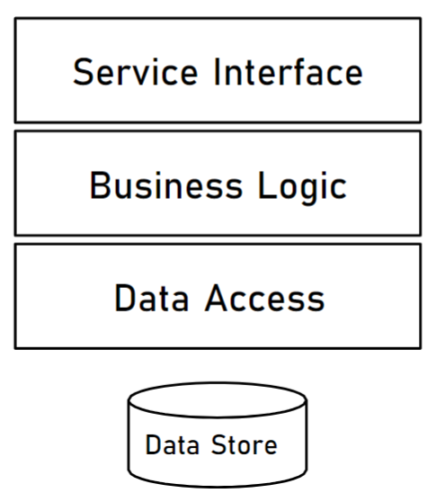
Architecture
Source: Dunderly case study-Example.pdf
Collect list Service (Online)
Notes:
This slide is inspired by the Dunderly case study-Example.pdf

Slide 27
API
Get lists
Get one list
Validate items (mark items as collected)
Invalidated items (unavailable items)
Validate lists (list done)
Collect list Service (Online)

Slide 28
API
Functionality | Path | Return codes
Get lists | GET api/v1/lists | 200 OK
Get one list | GET api/v1/lists/{id_list} | 200 OK 404 Not Found
Validate items (mark items as collected ) | POST api/v1/lists/{id_list}/{id_item}/validate | 200 OK 404 Not Found
Invalidated items (unavailable items) | POST api/v1/lists/{id_list}/{id_item}/invalidated | 200 OK 404 Not Found
Validate lists (list done) | POST api/v1/lists/{id_list}/validate | 200 OK 404 Not Found
Collect list Service (Online)

Slide 29
Mobile App on Azure
App service:
Supports many platforms (tablets)
Stadard tier has SLA 99,95%
Collect list Service (Online)
Notes:
Instance 2 because we have 100 users.

Slide 30
Components
Tablets
App service
HTML page
Offline service
Online service
App service
REST API/ HTTP
Queue
Payment Transfert
Logging
Payment Engine

Slide 31
Collect list Service Offline part
What it does :
The application must still work offline
Store data locally and mark items as collected or unavailable
Synchronise data after connection return
Collect list Service (Offline)

Slide 32
Application Type
Web App & Web API - ✗
Mobile App - ✔
Console - ✗
Service - ✗
Desktop App - ✗
Collect list Service (Offline)

Slide 33
Technology
Azure Offline Data Sync:
Enables data to be synchronised between client and database after disconnect
Azure Database compatible
Collect list Service (Offline)
Notes:
Source : https://learn.microsoft.com/en-us/azure/developer/mobile-apps/azure-mobile-apps/quickstarts/xamarin-forms/offline?pivots=vs2022-windows

Slide 34
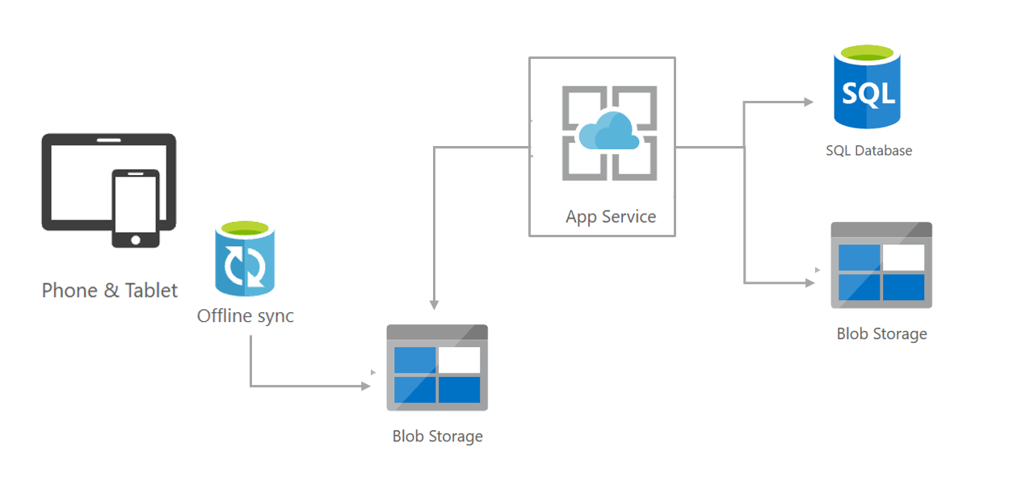
Architecture
Source: https://microsoft.github.io/techcasestudies/mobile%20application%20development%20with%20xamarin/2017/04/20/dnvgl.html
Collect list Service (Offline)
Notes:
Source: https://microsoft.github.io/techcasestudies/mobile%20application%20development%20with%20xamarin/2017/04/20/dnvgl.html

Slide 35
Components
Tablets
App service
HTML page
Offline service
Online service
App service
synchronize
REST API/ HTTP
Queue
Payment Transfert
Logging
Payment Engine

Slide 36
Payment transfert
What it does :
When collection is done, the list should be transferred to payment engine
Payment transfert

Slide 37
Application Type
Web App & Web API - ✗
Mobile App - ✗
Console - ✗
Service - ✔
Desktop App - ✗
Payment transfert

Slide 38
Technology Stack
Payment transfert

Slide 39
Components
Tablets
App service
HTML page
Offline service
Online service
App service
synchronize
REST API/ HTTP
Queue
App service
Logging
Payment Engine
Notes:
We're the App service for Payment Transfert. This service just transfert payment to an external service (payment engine)

Slide 40

Front End

Slide 41
Security
Access restrictions
Database
Network security
Expose in internet
Need to add Web Application Firewall (WAF)

Slide 42

Architecture Diagram
Tablets
Collect lists service
App service
Mobile app
WAF
Offline service
Online service
App service
synchronize
Queue
View service
Payment transfert
logging
App service
Logging
Payment Engine

Slide 43
Cost
Estimated upfront cost - 0,00 $
Estimated monthly cost - 1638 $

